Slide 1
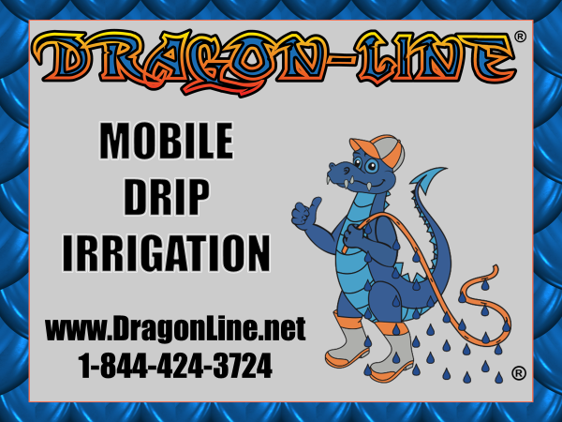

Slide 2
WHY
DRAGON-LINE
IS A GOOD INVESTMENT FOR YOUR CUSTOMER!

Slide 3
Why DRAGON-LINE?
Dragon-line is the newest and most efficient way for your customers to:
Save 20-50 percent of current water being used
Grow more crop with less water
Help solve and eliminate nasty wheel tracks
Keeps foliage dry reducing insect infestation
Significantly reduces evaporation and eliminates wind drift
Reduces run off, soil compaction, and crusting

Slide 4
Why DRAGON-LINE?
Eliminates over watering on inside spans
Allows for winter watering with no ice accumulation on system structure
Brings precision irrigation to precision farming
Less wear and tear on system drive train and components
More efficient use of fertilizer, herbicide, and pesticides
Reduce pumping cost up to 25 percent or more
Eliminate use and expense of maintaining pressure regulators
Dragon-Line emitters are pressure compensation and self-flushing

Slide 5
Why DRAGON-LINE?
Ease of pivot start-up after periods of shut down
Accuracy of watering of unlevel terrain because of pressure compensating emitters.
More accurate watering time of application because of dry wheel tracks and no tire slippage
Pre-Irrigation with greater application rates each pass and less compaction, crusting, and deeper percolation
Less plant shock of cold water delivered to crop canopy

Slide 6
Potential Savings With Dragon-Line
Possible savings for 1 year of operation
Pumping cost reduction |  |  | $ 6,200.00
Wheel track maintenance |  |  | $ 750.00
Reduction of fertlizer |  |  | $ 2,000.00
Reduction of herbicides |  |  | $ -
Reduction of pesticides |  |  | $ 500.00
Pressure regulator replacement |  |  | $ 200.00
Less wear and tear on system |  |  | $ 500.00
(No water on motor, Gearbox)
Expense of system being stuck |  |  | $ 500.00
(Labor, water, pumping, yeild loss)
Other |  |  | $ -
Other |  |  | $ -
 | Total saving per year |  | $ 10,650.00
 | Total savings 10 years |  | $ 106,500.00
 | Dragon-Line cost |  | $ 25,000.00
 | Net Difference |  | $ 81,500.00

Slide 7
WHY
DRAGON-LINE
IS A GOOD INVESTMENT FOR YOUR COMPANY!

Slide 8
WHY DRAGON-LINE?
Potential Sales for Every Center Pivot in Your Sales Territory
Generate 30-50 Percent Profit on Parts
Generate Labor Sales for Service Department or Contractor
Establish Leadership for Water Conservation and Technology in Precision Irrigation
Provide a Solution for Many Unsolved Current Problems That Plague Irrigators

Slide 9
DRAGON-LINE CALCULATOR
Custom Designs Pivot Profile
Calculates Four Styles Of Dragon-Line With One Page Of Input
Individually Add Or Remove Items Not Required
Automatically Builds 50% Margin Into Quotes For Completed System Style And Projected Labor Costs For Installation
Custom Input Costs From Own Company Parts, Labor, Filters And Installation
Assimilates And Generates A Detailed Sales Quote For Customer

Slide 10
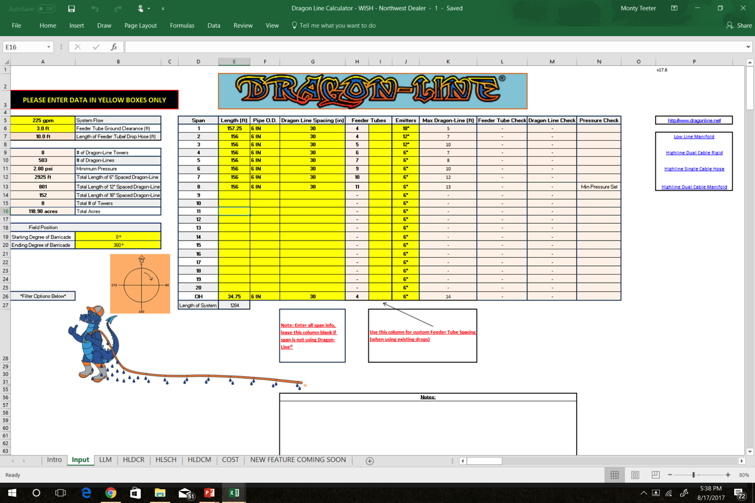
DRAGON-LINE CALCULATOR

Slide 11
Dealership Potential Yearly Profits With Dragon-Line
Parts
 |  |  | X |  |  |  | =
Number Of Systems |  |  |  | Dollars Of Margin |  |  |  | Parts Gross Profit
Labor
 |  |  | X |  |  |  | =
Number Of Systems |  |  |  | Dollars Of Margin |  |  |  | Labor Gross Profit
 |  |  |  |  |  |  |  | Total Gross Profit

